Slide 1


What is React? Why would we use it?

Slide 2
What is rEact
React is a JavaScript library developed and maintained by Facebook.
According to the creator of React JS, Jordan Walke, it is declarative, efficient, and flexible JavaScript library for building user interfaces.
It lets you compose complex UIs from small and isolated pieces of code called “components”.
https://reactjs.org/

Slide 3








Some Big companies using react
Facebook
Netflix
PayPal,
Airbnb
Dropbox
Salesforce
Uber
Tesla
Atlassian

Slide 4
Why REACT
It has very strong community support, such as Stack Overflow, discussion forums (such as DEV's React community, Reddit's React community, etc.)
Potential to reuse components. It saves time for developers.
Some key benefits of using React JS:
Speed, Simplicity, Easy to learn, Performance, Flexibility, Testability

Slide 5
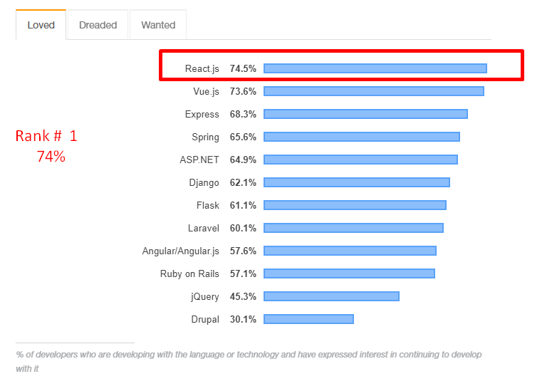
Most loved web framework platform
According to Stackoverflow : React.js is the most loved and most wanted web frameworks by developers.

Slide 6
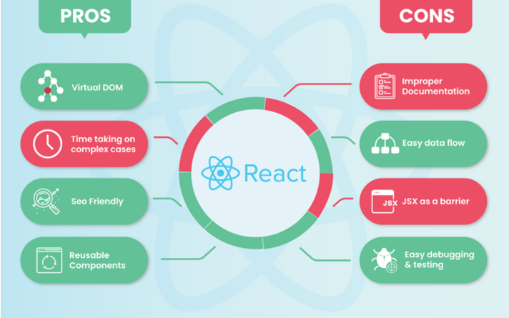
Pros and cons

Slide 7
Thank You
React is an excellent tool with which to create interactive applications for mobile, web, and other platforms.
With new libraries and web frameworks being developed every year, it is tough to predict which technology is here for the long term. But ReactJS has proved its durability for the last 10 years.
any questions? AAMIRPERVEZ27@GMAIL.COM

